Slide 1
Data Structures
Master’s Theorem

Slide 2
Master’s Theorem:
It is applicable for recursive functions
T(n ) = aT(n/b)+ O(n^{k} log^{p}n)
Where a >= 1,b > 1 ,k >= 0 and p is a real number
Case1: If a > b^{k}, then T(n) = O(n^{log}_{b}ª)
Case 2: if a = b^{k} ,then T(n)
2a : if p> -1,then T(n)= O(n^{log}_{b}ª *log^{p+1}n)
2b : if p = -1 ,then T(n) = O(n^{log}_{b}ª *log logn)
Case 3: if a<b^{k} , then T(n) = O(n^{k}log^{p}n)

Slide 3
1. T(n) = 3T(n/2) +n²
T(n ) = aT(n/b)+ O(n^{k} log^{p}n)
A= 3 , b= 2 ,k=2, p=0
a < b ^k
3 < 2^2
3 < 4
Case 3: if a<b^{k} , then T(n) = O(n^{k}log^{p}n)
T(n) = O(n²log⁰n)
=O(n²)

Slide 4
2.T(n) = 4T(n/2)+n²
3. T(n) = T(n/2) +n²
4. T(n) = 2^nT(n/2)+n^{n}
5.T(n) = 16T(n/2)+n
6.T(n) = 2T(n/2)+nlogn
7.T(n) = 2T(n/2)+n
8.T(n) = 3T(n/4) +n ^{0.51}
9.T(n) = 64T(n/8) – n²logn
10.T(n) = 6T(n/3)+n²logn

Slide 5
Master’s Theorem:
It is applicable for recursive functions
T(n ) = aT(n/b)+ O(n^{k} log^{p}n)
Where a >= 1,b > 1 ,k >= 0 and p is a real number
Case1: If a > b^{k}, then T(n) = O(n^{log}_{b}ª)
Case 2: if a = b^{k} ,then T(n)
2a : if p> -1,then T(n)= O(n^{log}_{b}ª *log^{p+1}n)
2b : if p = -1 ,then T(n) = O(n^{log}_{b}ª *log logn)
Case 3: if a<b^{k} , then T(n) = O(n^{k}log^{p}n)
2.T(n) = 4T(n/2)+n²
3. T(n) = T(n/2) +n²
4. T(n) = 2^nT(n/2)+n^{n}
5.T(n) = 16T(n/2)+n
6.T(n) = 2T(n/2)+nlogn
7.T(n) = 2T(n/2)+n
8.T(n) = 3T(n/4) +n ^{0.51}
9.T(n) = 64T(n/8) – n²logn
10.T(n) = 6T(n/3)+n²logn

Slide 6
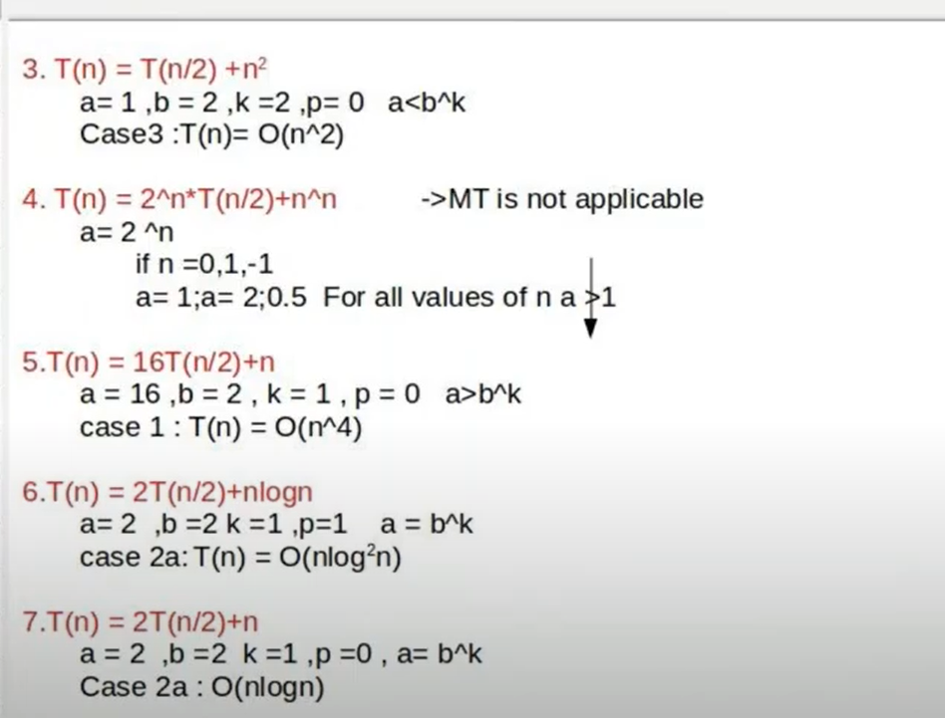

Slide 7
